Slide 1

Regional Internet Service Expansion
(RISE) Project
The Power of Partnerships

Slide 2




Madison County
Project Partners
Firefly Fiber Broadband
Rappahannock Electric Cooperative
Madison County
Thomas Jefferson Planning District Commission

Slide 3
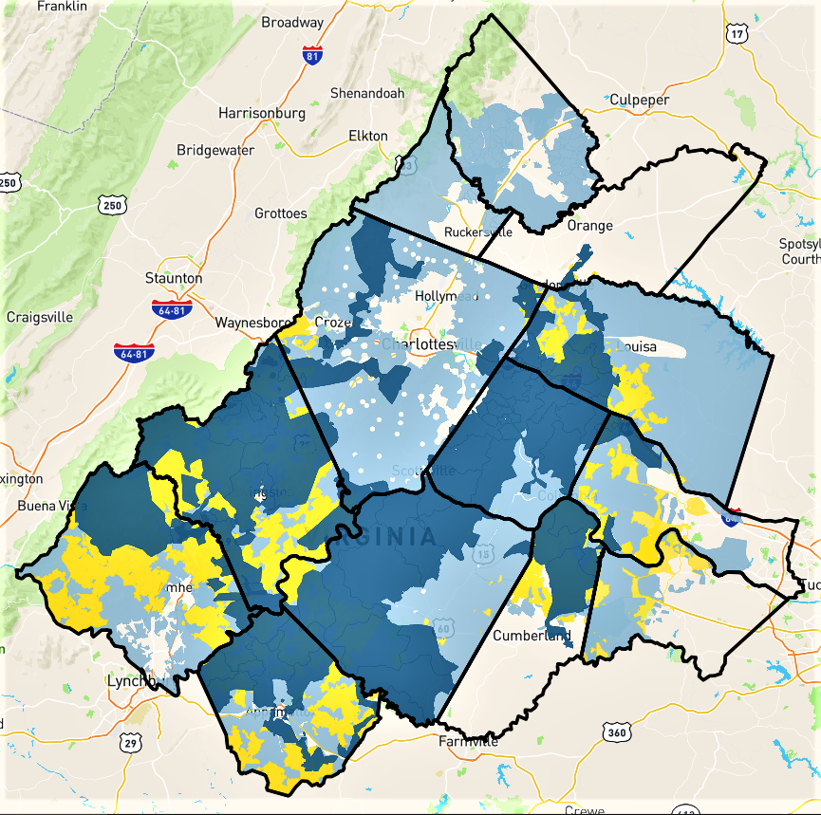

RISE Proposed Project Area
Federal Funding
RISE

Slide 4
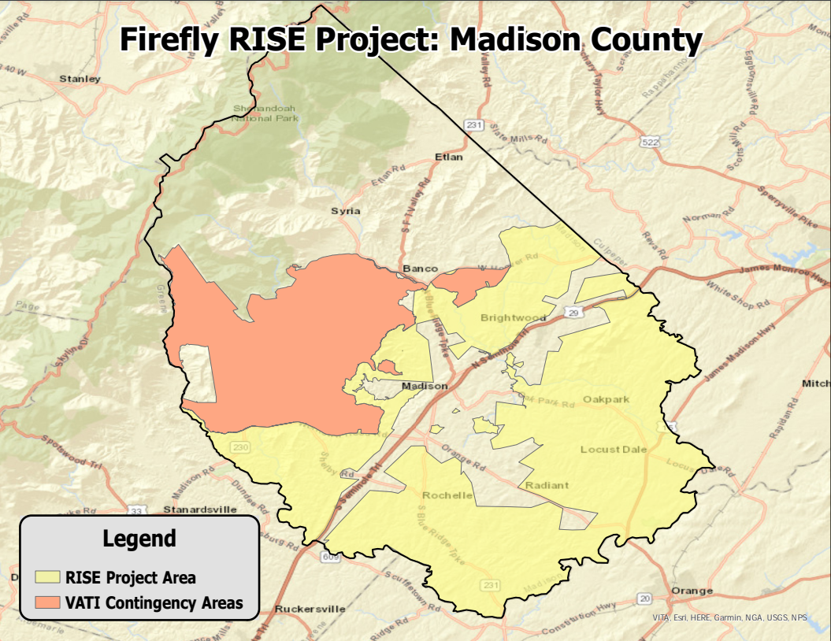

Slide 5
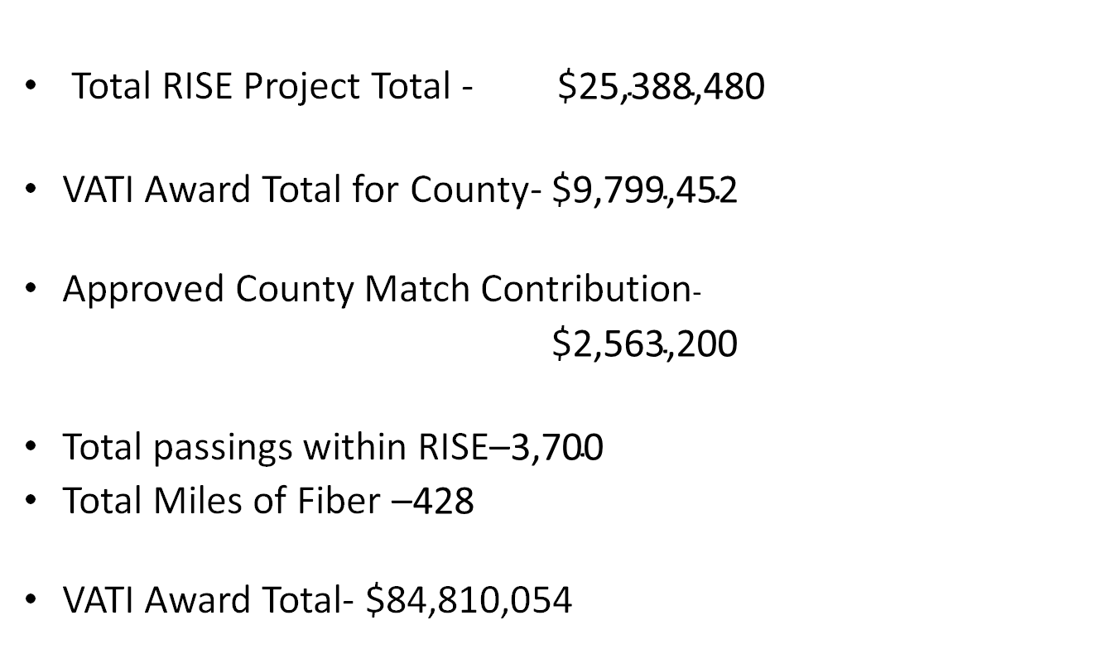
RISE Figures incl. Incumbent Overlap
Total RISE Project Total - $${\text{25,388,480}}^{}$
VATI Award Total for County- $${\text{9,799,452}}^{}$
Approved County Match Contribution-
$${\text{2,563,200}}^{}$
Total passings within RISE–${\text{3,700}}^{}$
Total Miles of Fiber –${\text{428}}^{}$
VATI Award Total- $${\text{84,810,054}}^{ }$

Slide 6
RISE Figures with incumbent serving its native locations (no overlap)
Total RISE Project Total - $22,100,820
VATI Award Total for County- $8,546,028
Approved County Match Contribution-
$2,101,000 (represents discount)
Total passings within RISE– 3,020
Total Miles of Fiber – 376
VATI Award Total- $79,027,930

Slide 7
Steps of Fiber Construction and Timeline
Generally, assume six months from start of construction until first in home connections. Will continue to work until all who would like service are connected.
Each area requires several steps before connections can be made:
Data collection (Firefly - NTS)
Design (Firefly - Conexon)
Make ready engineering (REC Contractors)
Make ready construction (REC Contractors)
Fiber construction (Firefly - S&N)
Splicing (Firefly - S&N)
Service extensions to homes (Firefly - S&N)
Final connection (Firefly)

Slide 8
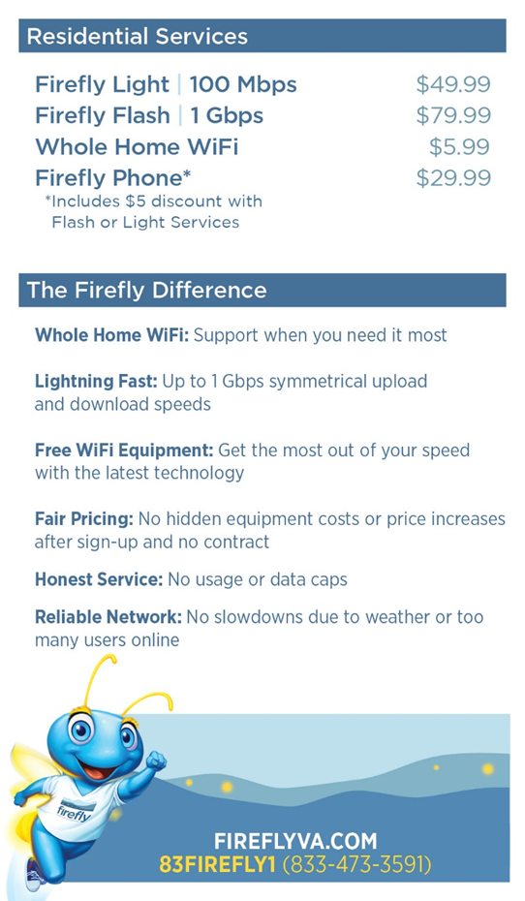

Committed to Affordable Service

Slide 9
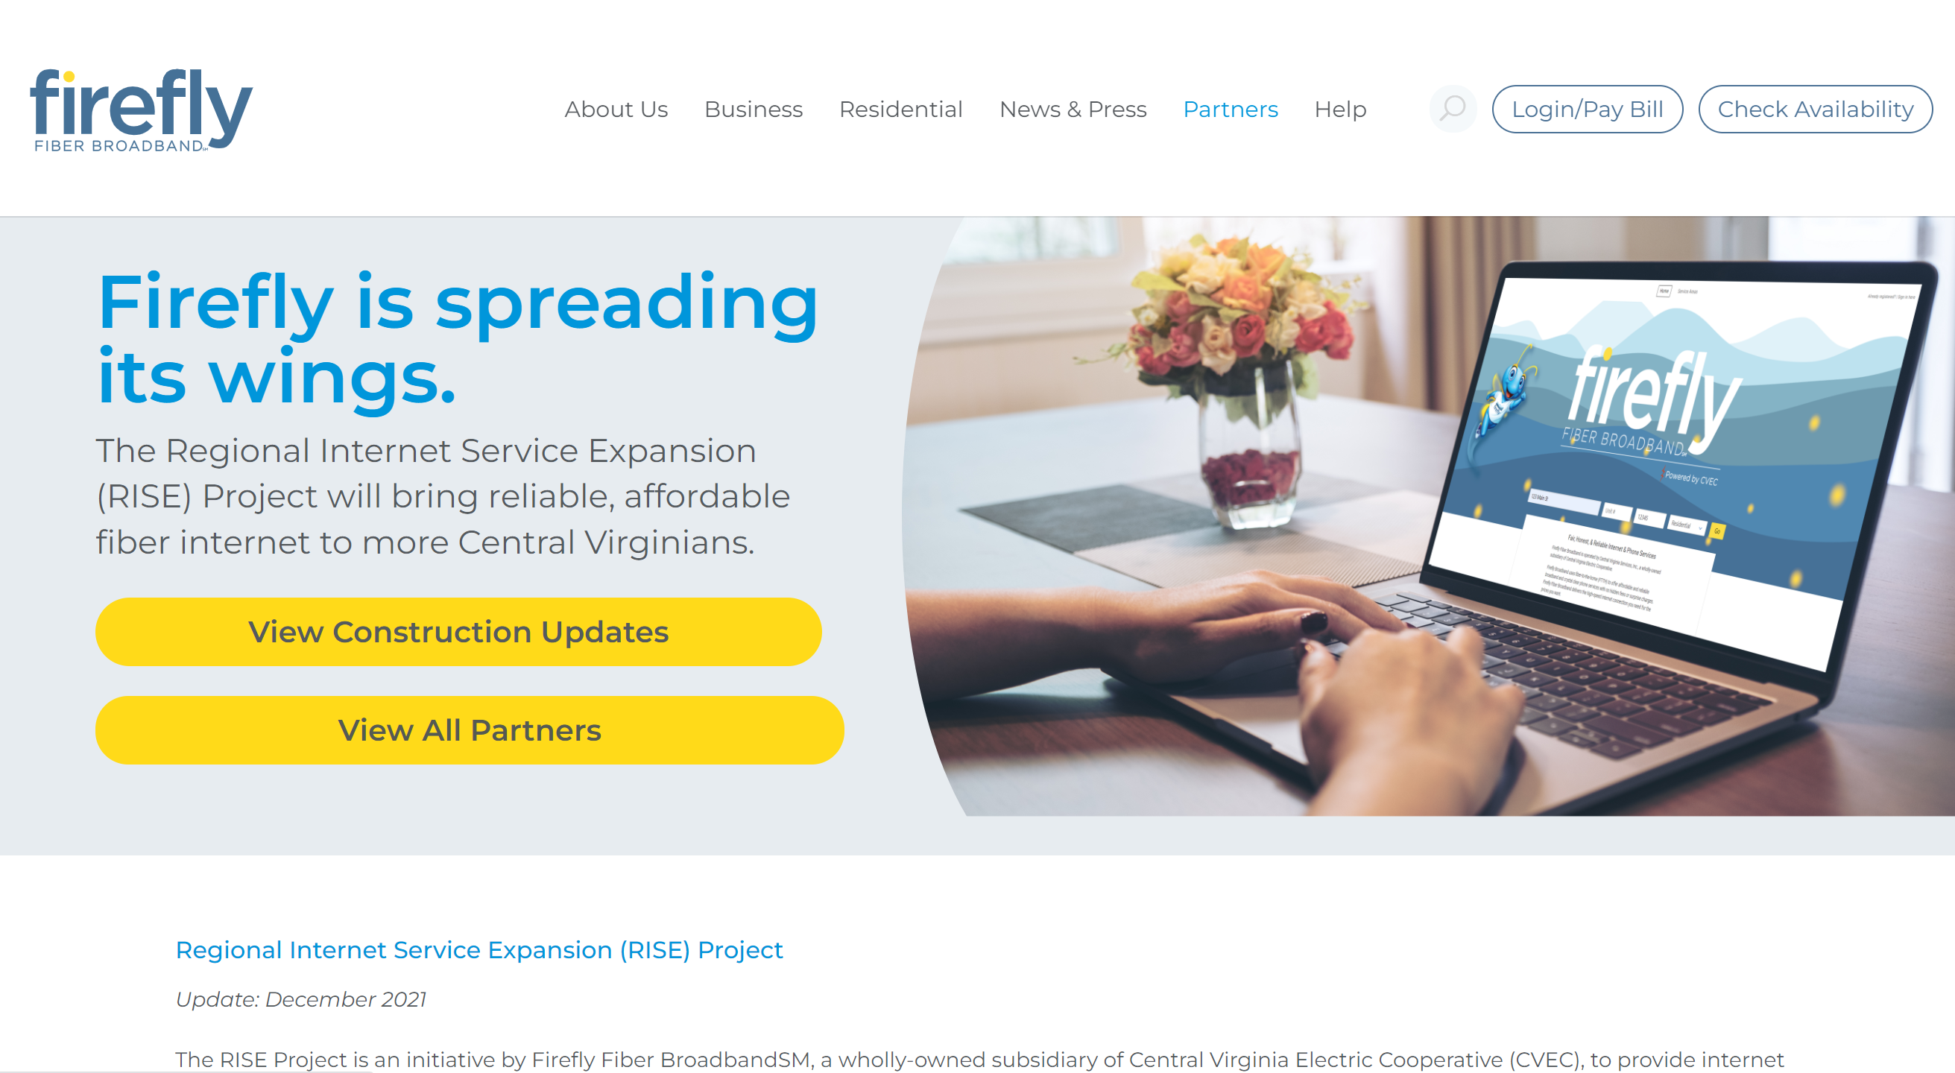
Questions? Visit our online resources
Have questions on whether your location is in our RISE Project?
Visit: https://www.fireflyva.com/rise/

Slide 10
Future Considerations in Madison
Next Round of VATI Funding
Proposed guidelines have changed this year to include any area that is not receiving 100mbps download and 20mbps upload speed (100/20)
If an area does not receive this level of speed, it is eligible for funding regardless of whether it has received state or federal funding in the past.

Slide 11
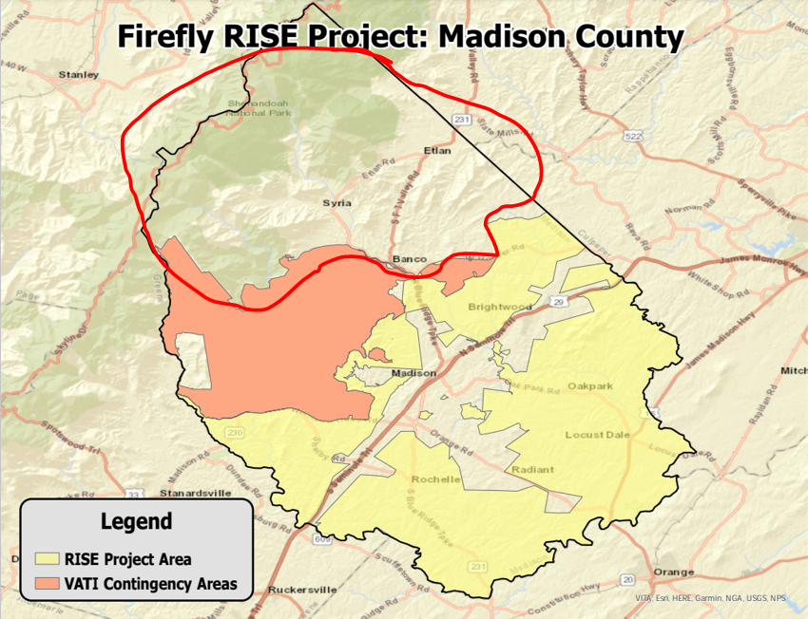
Future Considerations in Madison
Generally, the circled FCC RDOF funded area was bid at a speed of 50mbps/5mbps
This area would be eligible for funding under VATI guidelines.
Firefly would be pleased to offer a response to a county RFP regarding areas in the county not meeting the VATI threshold speed of 100/20mbps

