Slide 1

Regional Internet Service Expansion
(RISE) Project
The Power of Partnerships

Slide 2
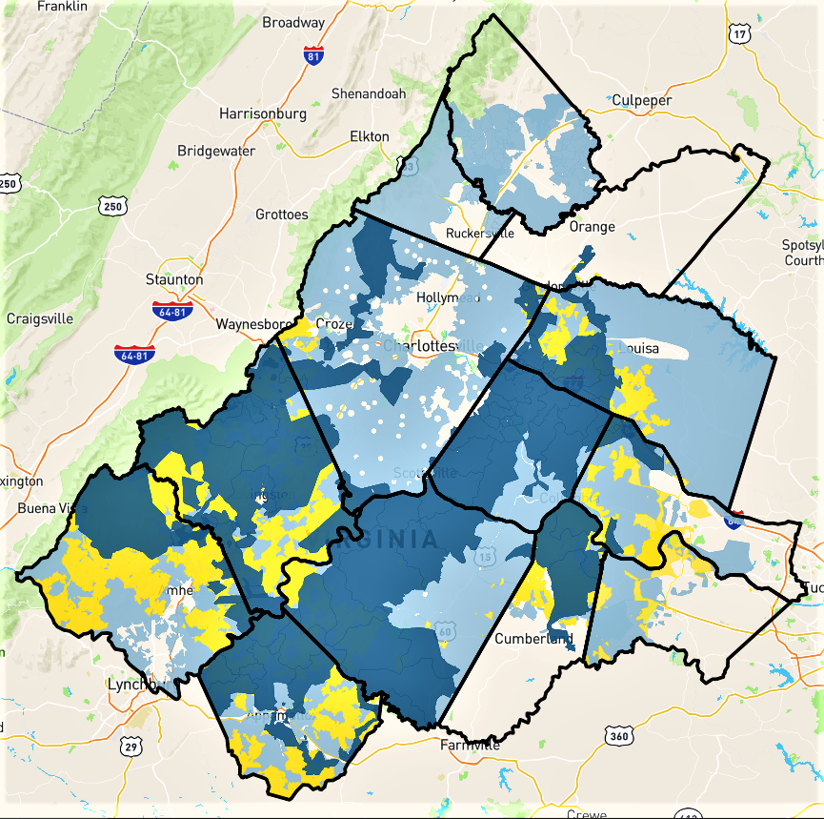

RISE Proposed Project Area
Federal Funding
RISE

Slide 3
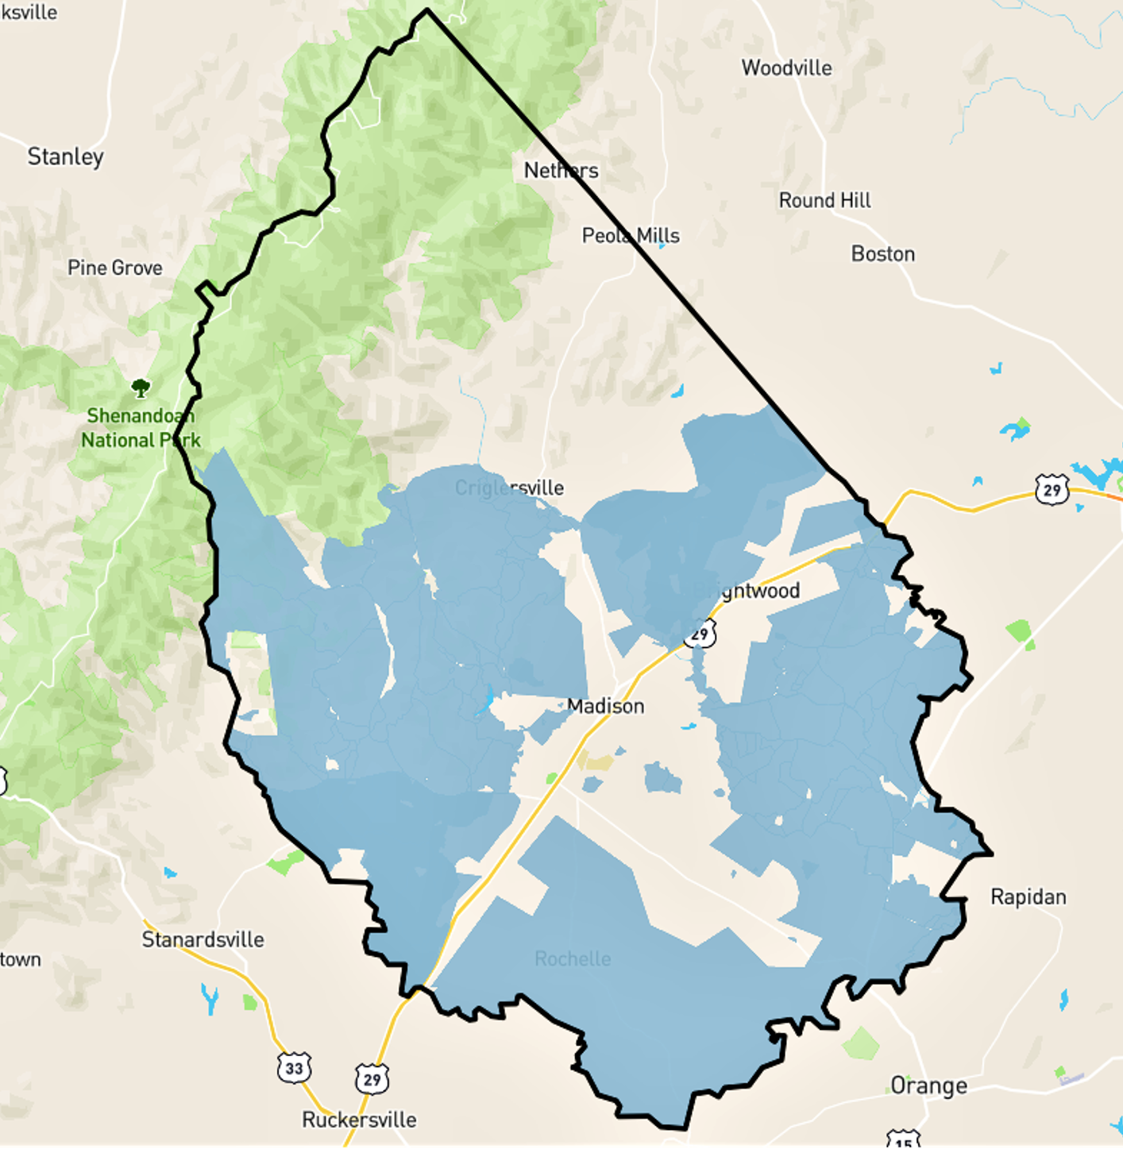

Madison County Coverage

Slide 4




Madison County
Project Partners
Firefly
Rappahannock Electric Cooperative
Madison County
Thomas Jefferson Planning District Commission

Slide 5
Project Figures
Total Electric Accounts in Madison | Total Electric Accounts
 | Rappahannock Electric | 7,492
 | Dominion | 140
 | *Assume 10% of electric accounts will never take broadband service (barns, electric fences, water troughs, etc)
Project Details | Project
 | Total Unserved Passings | 3,204
 | Total Fiber Miles | 395
Project Costs | Project Costs
 | Total Fiber Network Construction Cost | $25,675,000
Share of Construction Costs | Share of Construction Costs
 | Firefly | $15,367,300
 | VATI Request | $7,744,500
 | County Request | $2,563,200

Slide 6
Project Schedule
August 2021 – Board makes decision on participation
September 14 – VATI application due
December 2021 – VATI awards announced
Later in 2022 - Construction begins
2025 – Finish Build by year end
Generally assume six months from start of construction until first in home connections. Will continue to work until all who would like service are connected.

Slide 7


Proposed Resolution for Madison
Whereas Madison County is committed to bringing universal broadband internet access to its citizens across the county within the next three years, and
Whereas Firefly Fiber Broadband, Dominion Energy and Rappahannock Electric Cooperative have developed a regional internet service expansion project with the Thomas Jefferson Planning District Commission as the lead applicant with the county being one of multiple counties included in the project to make fiber to the home broadband internet service available to the unserved locations in the county, and
Whereas the preliminary planning for the regional project has identified 3,204 locations in the county as being unserved without access to speeds faster than 25 mbps download or 3 mbps upload, and the preliminary design includes 395 miles of fiber optic cable to be installed in the county to make service available to those locations, with a cost estimate of $25,675,000 for the construction, creating a need for additional grant funding to make the project financially feasible, and
Whereas this project will seek grant funds from the Virginia Department of Housing and Community Development through its Virginia Telecommunications Initiative (VATI) with an application on or before 14 September 2021, and that application process provides additional scoring points for local contributions to the project, then
Be it resolved that Madison County will participate in the regional project and fully support the application including providing local matching funding not to exceed $2,563,200.

